Slide 1
A Brief Survey of Anomaly Detection in Smart Grid
Sreeja Matturu
Hasan Al-Qudah

Slide 2
List of Contents
Introduction about Smart Grid
Why Anomaly Detection in Smart Grid
Types of Anomalies
Security Objectives and Challenges
Types of Attacks in Smart Grid
Proposed Anomaly Detection Techniques
Lessons Learned
Conclusion and Future Work

Slide 3
What is Smart Grid?
"The grid," refers to the electric grid, a network of transmission lines, substations, transformers and more that deliver electricity from the power plant to your home or business.
In short, the digital technology that allows for two-way communication between the utility and its customers, and the sensing along the transmission lines is what makes the grid smart.
https://www.smartgrid.gov/the_smart_grid/smart_grid.html

Slide 4

Smart Grid Operation

Slide 5
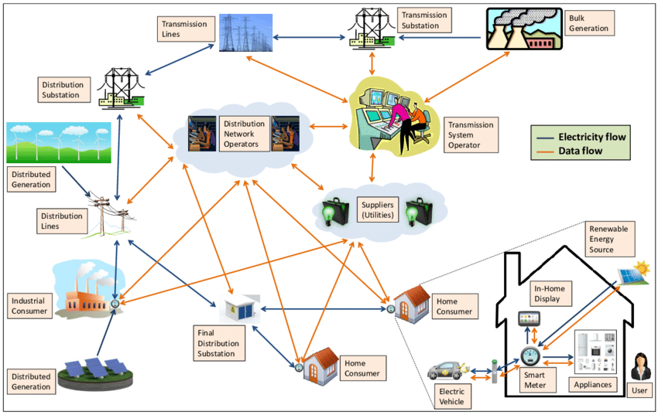
Smart Grid Architecture
Mustafa, Mustafa A.. (2015). Smart Grid Security: Protecting Users’ Privacy in Smart Grid Applications. 10.13140/RG.2.2.21284.12169.

Slide 6
Why Anomaly Detection in Smart Grid?
Ability to acquire the data about electricity usage every micro-second.
Whatever the data is produced may not be the clean data as it may have some irregularities.
Data irregularities are potentially caused by some accidental errors or malicious attacks.
These kind of errors might lead to deliver wrong information and makes wrong decision on the system.

Slide 7
Types of Anomalies
Point Anomalies
Contextual Anomalies
Collective Anomalies

Slide 8
Security Objectives
Confidentiality
Integrity
Availability
Authentication
Authorization
Non-Repudiation

Slide 9
Security Challenges
Privacy
Connectivity
Trust
Software Vulnerabilities

Slide 11
Proposed Anomaly Detection Techniques
Physical Attacks
Anomalous power consumption attack patterns - wavelet transform, variance fractal dimension and artificial neural network.
Power fluctuations - Map Reduce Paradigm.
Detecting electric faults in a power distribution grid - power line modems.
An IoT based Distributed Anomaly Detection - operation energy consumption
Detecting the occurrence of anomalous events and abnormal conditions at both lateral and customer levels using an anomaly detection method based on network hierarchical structure and smart meter data

Slide 12
Detecting Integrity Cyber Attacks
False Data Injection Attack
Semi- supervised approach based on mixture Gaussian Distribution for detecting the false data injection.
Machine learning techniques Bad Data Detection (BDD) and Distributed Support Vector Machine (SVM) to detect the stealth false data detection.
Maximum Likelihood estimation, a powerful statistical tool to detect stealthy false data injection attacks.
S-Estimator based extended Kalman Filter for detecting the topology errors and cyber attacks.
Adaptive Markov Strategy for detecting the false voltage injection attacks in smart grid.

Slide 13
Detecting Data Falsification Strategies
Statistical based anomaly detection technique to identify the additive and deductive attacks in Advance Metering Infrastructure (AMI).
Proposed technique was implemented based on a trust model called Kullback-Leibler divergence.
For detecting the camouflage and conflict strategies, a generalized linear model based on Weibull function-based kernel trick is used for accurate classification.
For detecting the malicious attacks which disrupts the daily operations, a rapid anomaly detection is proposed based on light-weighted pattern matching technique.

Slide 14
Detecting Availability Target Attacks
Denial-of-Service
Anomaly detection using K-Means clustering algorithm to detect flooding attacks which mainly leads to Denial-of-Service attacks in Home Area Network.
A delay-resilient cyber-physical control framework for Denial-of-Service and communication latency issues in a smart grid.
Distributed Denial-of-Service
DDoS detection in Advance Metering Infrastructure using honeypot game strategy to analyze the interaction between the attackers and the defenders.

Slide 15
Lessons Learned
Smart Grid is the most efficient technology for transmitting the electricity by making a two-way communication in 21st century.
It is becoming more and more efficient by improving its standard with the smart technologies like smart meters, smart homes, etc. where the data that is produced by these devices are monitored by smart grid devices like PMU’s and SCADA systems.
Even though it has lot of positive points when compared to the traditional system, smart grid always prone to different attacks like cyber attacks and physical attacks which can cause huge loss to the entire system.
We came to know about different types of attacks and the techniques that were implemented to detect these threats.
We came across many number of techniques and frameworks that were developed and still a lot of research is going on.

Slide 16
Conclusion and Future Work
In this presentation, we described about what is smart grid and how it works efficiently for transmitting the electricity.
Different types of cyber attacks and physical attacks are discussed.
We discussed about the research on various anomaly detection techniques for detecting the attacks within the smart grid.
For future work, we want to explore more on anomaly detection techniques that were implemented on detecting the cyber-physical attack, which contains both cyber attacks as well as physical attacks.

Slide 17


